Slide 1
Analysis ON AN AIRBORNE rain ENHANCEMENT EXPERIMENT in northeastern Sichuan
Dan LIN^{1*}, Ping LIU¹, Guihua LIU², Weijia WANG^{3*}
1. Weather Modification Office of Sichuan Province, CMA
2. Meteorological Institute of Shanxi Province, CMA
3. Chengdu Meteorological Bureau, CMA

Slide 2
Outline
1
Introduction to RGB images and T-Re profiles
2
Application of RGB images and T-Re profiles
3
Case study of rain enhancement experiment

Slide 3
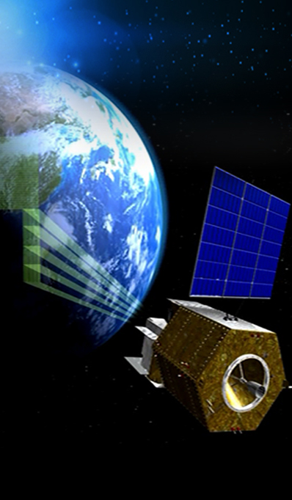
1 Brief introduction to RGB images and T-Re profiles
CMA FengYun

Slide 4
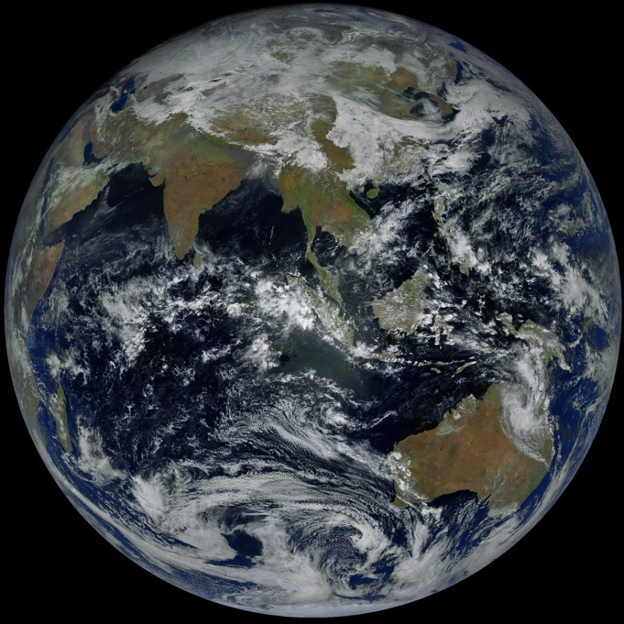
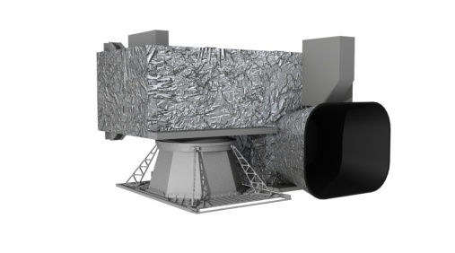
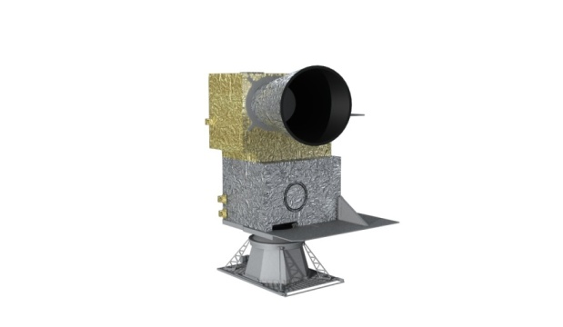
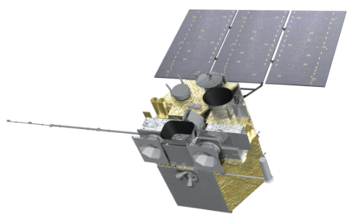
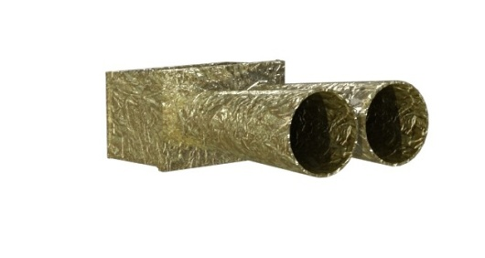
Satellite Payload of FY-4A
a new generation of China's geostationary meteorological satellite was successfully launched on December 11, 2016. And it was put into operation in March 2018.
AGRI：Advanced Geosynchronous Radiation Imager
GIIRS：Geo. Interferometric Infrared Sounder
LMI：Lightning Mapping Imager
SEP：Space Environment Package

Slide 5
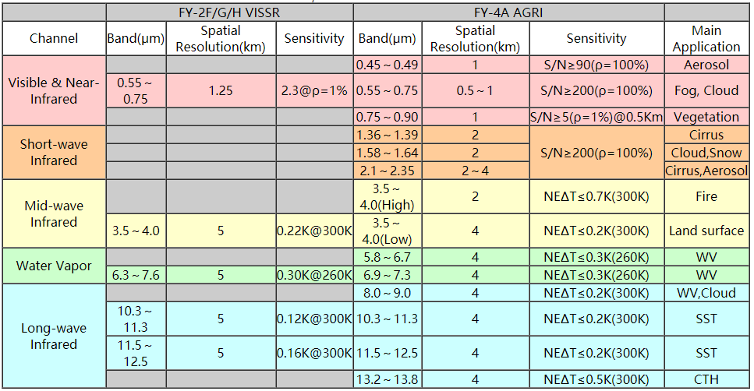
(1) AGRI Channels
AGRI ：14 channels. The spatial resolution of the visible channel is 0.5-1 km, the mid-infrared channel is 2 km and the long-wave infrared channel is 4 km.

Slide 6
Create Day Microphysical RGB composite imagery
FY-4A/AGRI
Band | Wavelength (μm) | Spatial Resolution (Km) | Physical Properties
1 | 0.45~0.49 | 1 | aerosol | Visible
2 | 0.55~0.75 | 0.5～1 | low cloud, fog
3 | 0.75~0.90 | 1 | vegetation | Near Infrared
4 | 1.36~1.39 | 2 | cirrus
5 | 1.58~1.64 | 2 | Cloud, snow
6 | 2.1~2.35 | 2～4 | Cirrus, aerosol
7 | 3.5~4.0 (high) | 2 | forest fire | Middle Infrared
8 | 3.5~4.0 (low) | 4 | low cloud, fog, forest fire
9 | 5.8~6.7 | 4 | mid- and upper level moisture | Infrared
10 | 6.9~7.3 | 4 | mid- level moisture
11 | 8.0~9.0 | 4 | cloud phase, SO2
12 | 10.3~11.3 | 4 | cloud imagery, sea surface temperature
13 | 11.5~12.5 | 4 | cloud imagery, sea surface temperature
14 | 13.2~13.8 | 4 | cloud top height
This scheme is displayed by compositing visible channel B02(0.65 μm) , near infrared channel B06(2.2μm) and infrared channel B12(11.0 μm).
The 2.2 micron image has reflection characteristics for particle phase and size in cloud. This is helpful to distinguish cloud layer, convective clouds and so on.
(RGB: B02/B06/B12)
R : B02 (V0.65)
G : B06(NI2.2)
B: B12(IR 11.0)

Slide 7
The visible 0.65um channel reflectance mainly depends on the cloud optical thickness.
higher cloud optical thickness → the higher reflectance → redder.
2.2um channel reflectance mainly depends on the size of the cloud droplet.
Smaller cloud droplet → larger reflectance → greener
11um channel reflectance depends on the cloud height.
lower cloud → higher black body temperature → bluer.

Slide 8
(1)Interpretation of Colors for “Day Microphysics”
High Cloud
Deep precipitating
cloud
Large ice particles
Deep precipitating
cloud
Small ice particles
Thin cirrus cloud
Large ice particles
Thin cirrus cloud
Small ice particles
Medium Cloud
Thick supercooled
water cloud
Large particles
Thick supercooled
water cloud
Small particles
Thin supercooled
water cloud
Large particles
Thin supercooled
water cloud
Small particles
Low Cloud
Thick water cloud
Large particles
Thick water cloud
Small particles
Thin water cloud
Large particles
Thin water cloud
Small particles

Slide 9
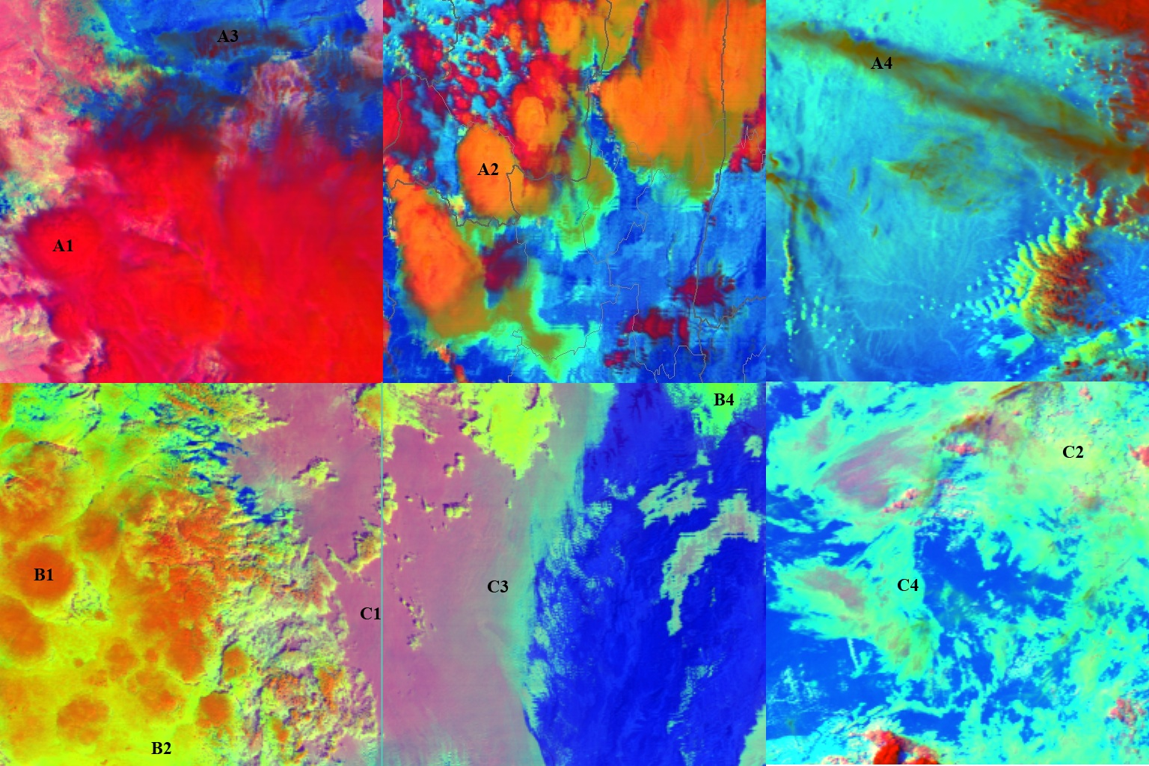
Cirrus cloud
Deep precipitating cloud
(precip. not necessarily reaching the ground)
- Bright, thick
- Large ice particles
- Cold cloud
Deep precipitating cloud
(Cb cloud with strong
updrafts and severe weather)
- Bright, thick
- Small ice particles
- Cold cloud
Supercooled water cloud
Water cloud
Supercooled water cloud
Water cloud
Water cloud
Supercooled water cloud

Slide 10
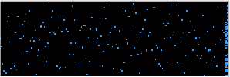
(2) T-Re profile
Height Temperature
7,073 m, -12.2 °C
6,793 m, -11.8 °C
6,124 m, -8.7 °C
5,816 m, -6.8 °C
4,406 m, +1.3 °C
These are images on different heights of the cloud.
It can be seen that vertically the H ↑, T↓, Re ↑.

Slide 11
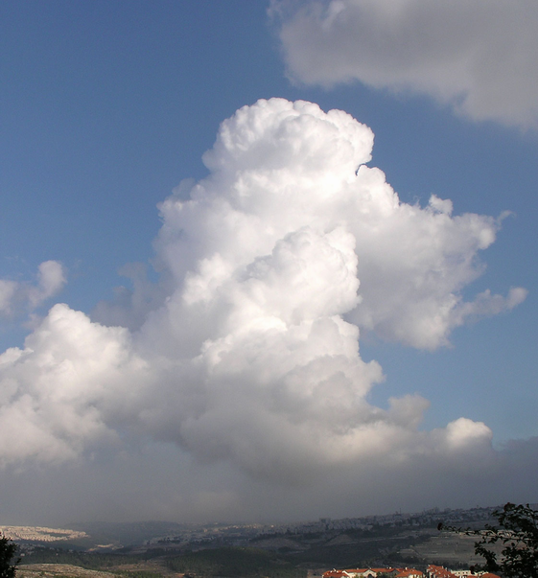
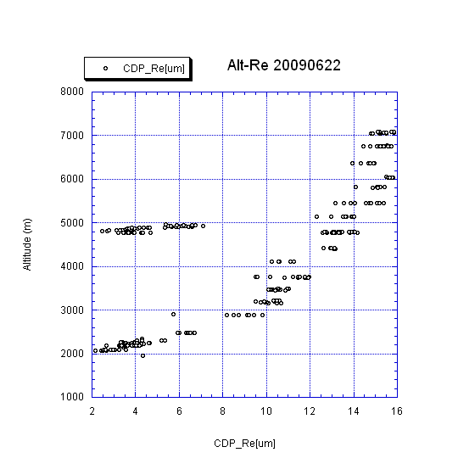
(2) T-Re profile
This is the vertical detection route for the aircraft.
Hyderabad, India
22 June 2009
Each point is cloud particle effective radius as measured by the aircraft during 1 second of flight.

Slide 12
(2) T-Re profile
Assumptions:
1.at a certain moment, in a certain region, the satellite observed different clouds with different cloud top height and particle effective radius, it can be considered as the development process of each cloud in this region over time.
Lensky I M, Rosenfeld D. The time space exchangeability of satellite retrieved relations betw een cloud top temperature and particle effective radius. A tmos Chem Phys, 2006, 6 ( 10 ) : 2887-2894.
2.Re near the cloud top is similar to Re in the cloud at the same height.
This assumption is tested by aircraft observations.
T= -20℃
Re at T= -10℃
Re at T= -10℃
same height

Slide 13
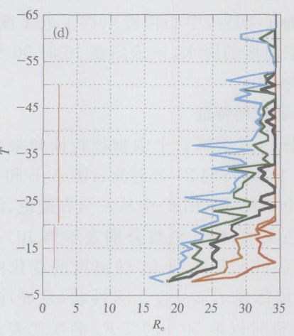
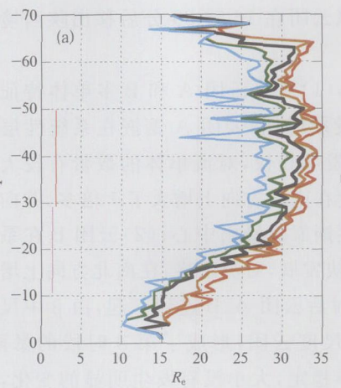
(2) T-Re profile
How to draw T-Re profiles
■Firstly, select the analysis region, and count the Re in this region at 1℃ intervals.
■Then arrange all Re at the same temperature in this region from smallest to largest.
■Since the number of Re at the same temperature is different, normalization process is carried out.
■The percentage of sample number is determined with 5% as the interval, 5% as the Re of the 5% sample, and 20% as the Re of the 20% sample.
■Finally, select different sample percentages and draw t-re.

Slide 14
Application of RGB Image
and T-Re Profile

Slide 15
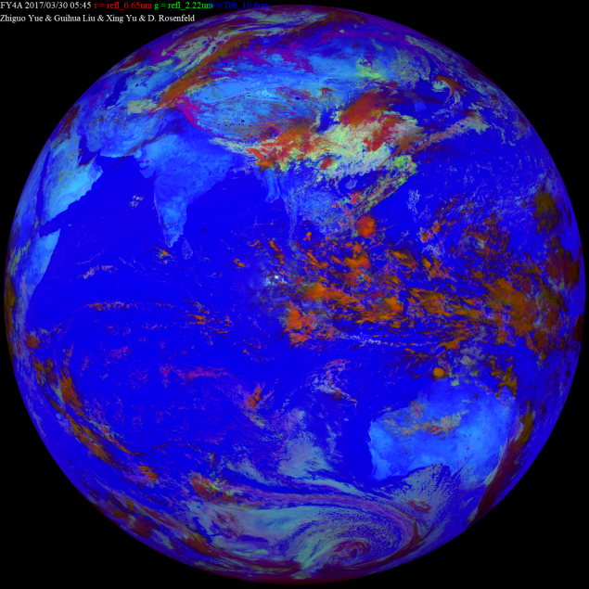
2. Application of RGB Image and T-Re Profile
RGB: the microphysical characteristics and distribution of the cloud.
T-Re: the vertical structure and development status of the cloud.
analyze weather processes
such as convective cloud, stratiform cloud, tornado, freezing rain.

Slide 16
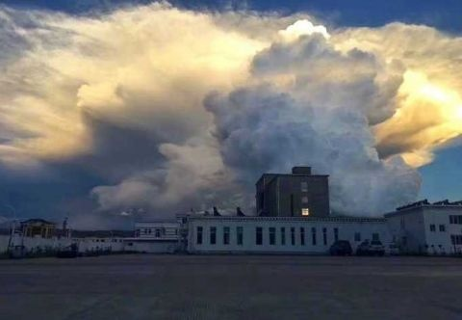
(1) Physical characteristic analysis of strong convective clouds
Compare the characteristics of different types of strong convective clouds precipitation processes,
it is found that the strong updraft signal is the key to the formation and occurrence of strong convection.
The strong updraft signal can be detected earlier by satellite.

Slide 17
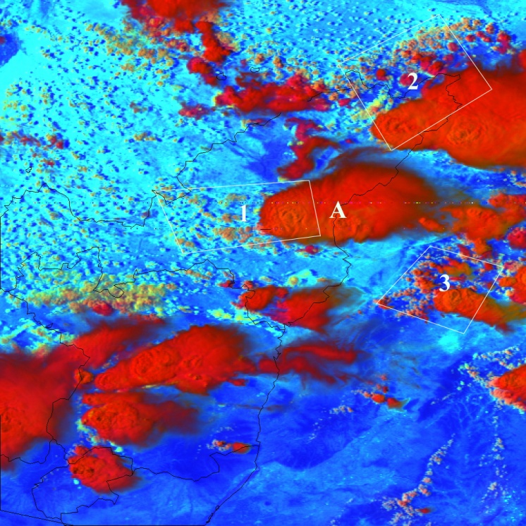
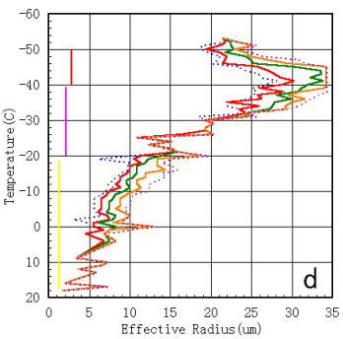
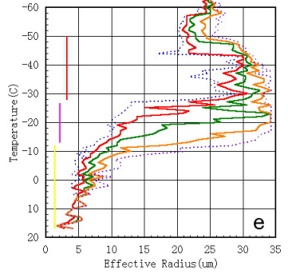
(1) Physical characteristic analysis of strong convective clouds
Example 1
On the afternoon of June 24, there is strong regional precipitation and hail in Northern Shanxi.
The precipitation begin at 16:00, accompanied by thunderstorm and hail.
RGB image and the corresponding T-Re profile at 15:13.
2.The ice crystallization temperature is low,
T~ -30℃.
makes the cloud has a deep supercooled water layer.
3.Starting from the - 40℃, the Re grows negatively until the cloud top, there are some small ice particles on this level.
－
－
1.Re is small, from the bottom of the cloud to the layer of -10℃, Re is between 5-10um.
－
－

Slide 18
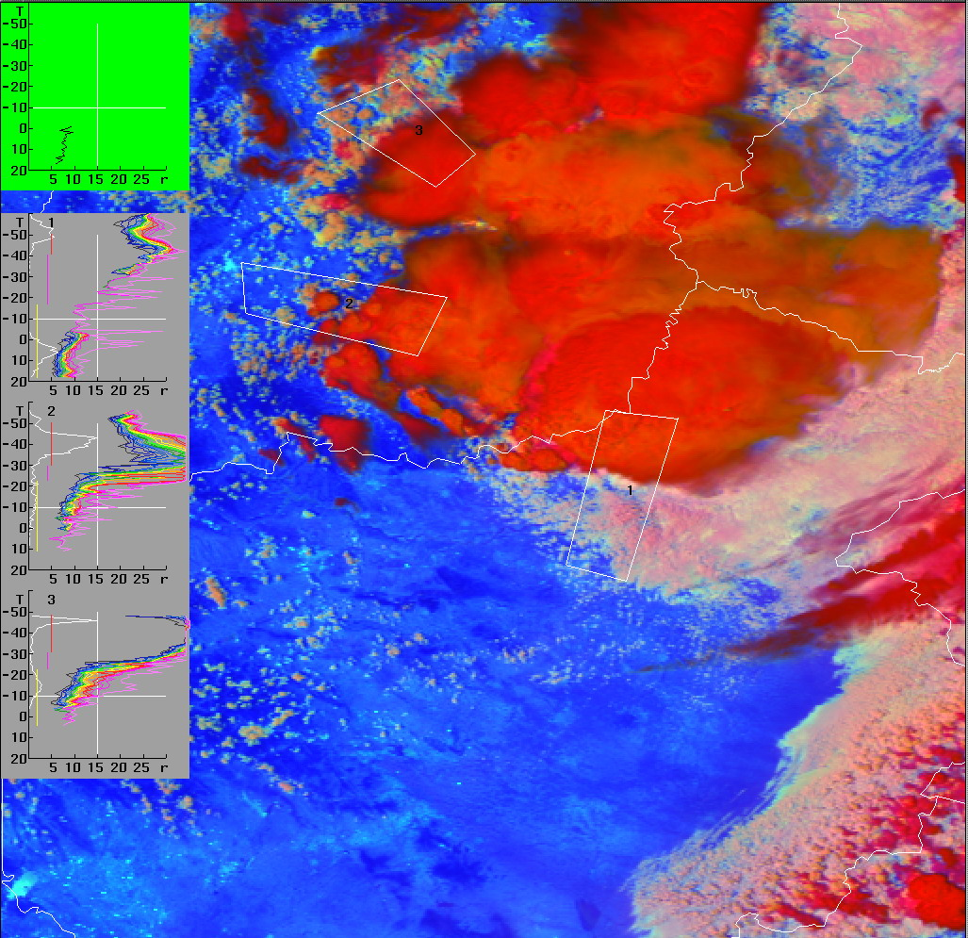
Example 2
On June 3, from 14:41 to 17:40, due to strong convective weather, parts of Henan Province are hit by strong winds and hail.
Figure are RGB image and the corresponding T-Re profile at 13:27.
Re near the bottom of the cloud is small, between 5-10um.
Re cannot grow sufficiently at the bottom layer, and the growth is slow with height.
The height of ice crystallization in the cloud is high.
The cloud top has small particles.

Slide 19
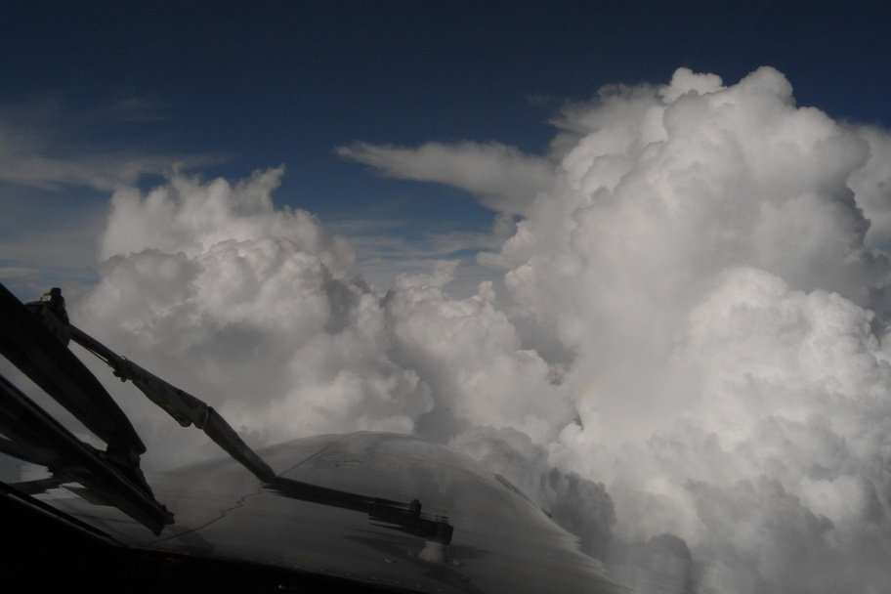
(2) Physical characteristic analysis of stratiform clouds
In most areas of China, stratiform cloud precipitation is the main precipitation cloud system in winter and spring, especially stratiform cold cloud.

Slide 20
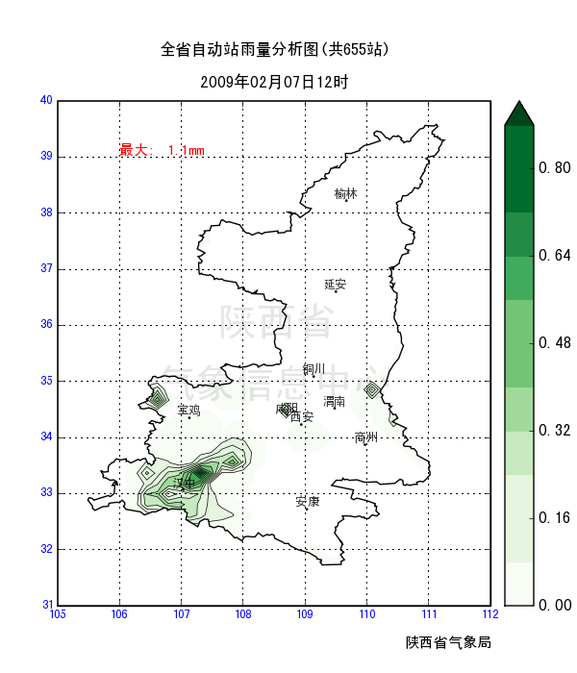
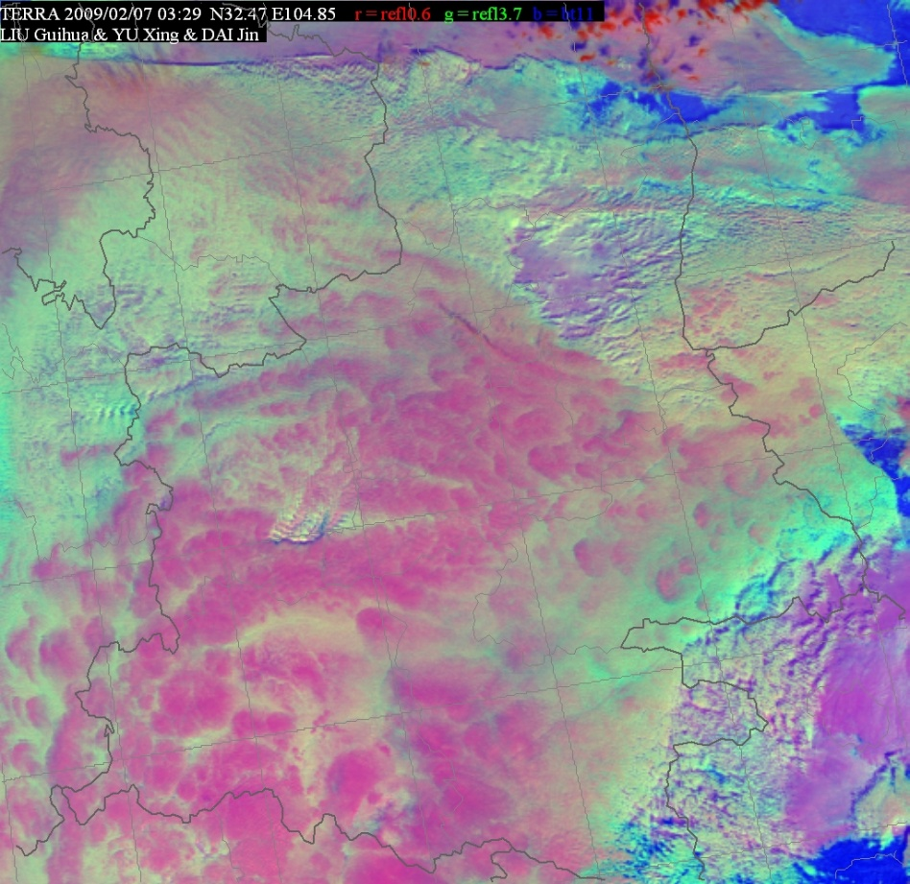
(2) Physical characteristic analysis of stratiform clouds
Example 1
The cloud top temperature is -6~-10℃
Re: 12~15um
Re: 5~8um
RGB image at 11:00 on February 7 and rainfall chart at 12:00

Slide 21
3 A case study of rain
enhancement experiment

Slide 22
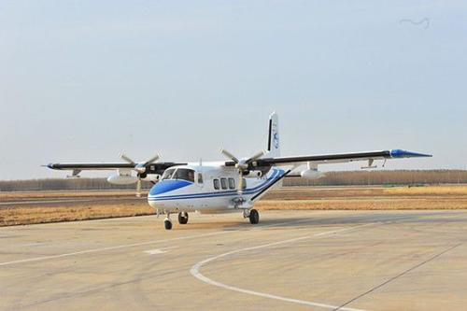
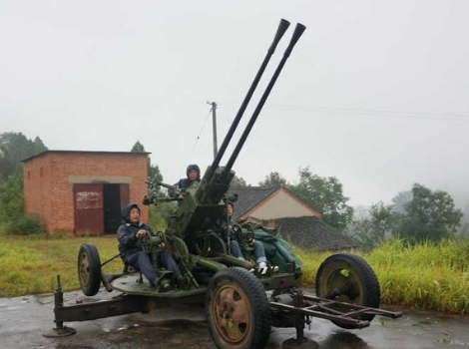
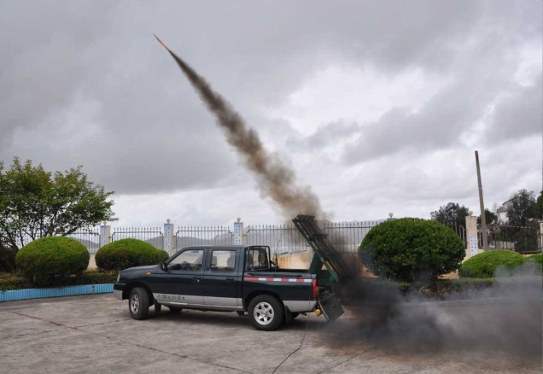
3. A case study of rainfall enhancement experiment
Stratiform is also the main object of artificial rain enhancement to alleviate droughts in Sichuan Province.
aircraft, rocket
catalytic effect
maximize the development of cloud water resources
lack ice crystals
have abundant supercooled water

Slide 23
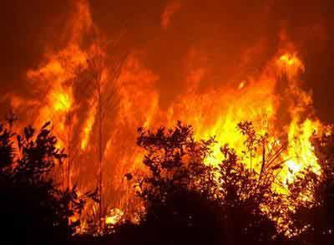
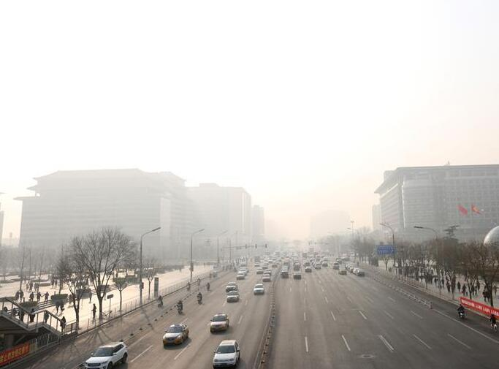
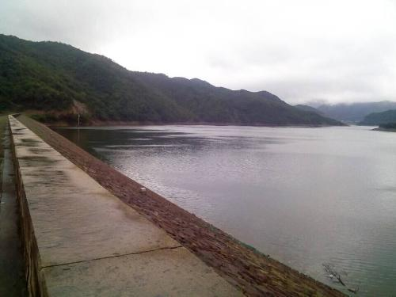
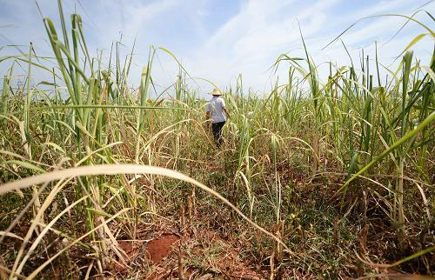
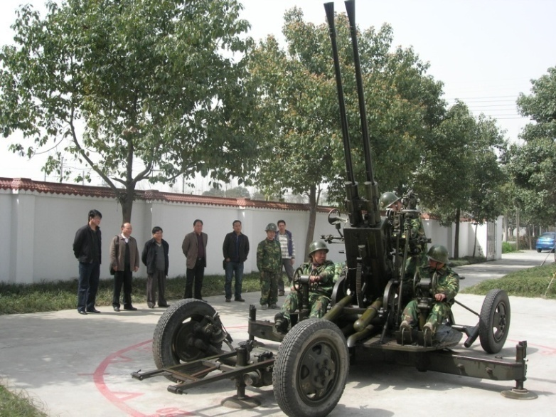
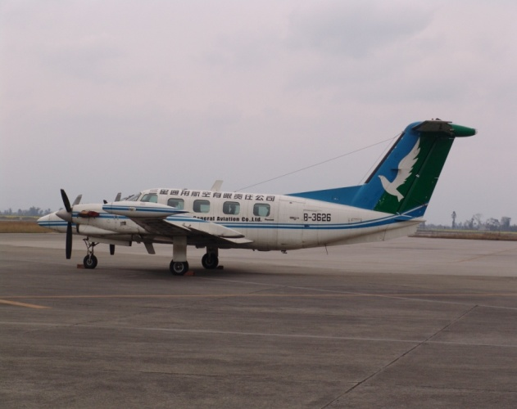
For my organization, Weather Modification Office of Sichuan Province, the main demand for artificial rain enhancement in our province comes from droughts, forest fires, haze and reservoir filling.
We conduct 30 to 40 airborne operations every year, and there are thousands of ground-based rain enhancement operations every year.

Slide 24
1 or 2 aircrafts are rented every year for airborne operations in my province.

Slide 25
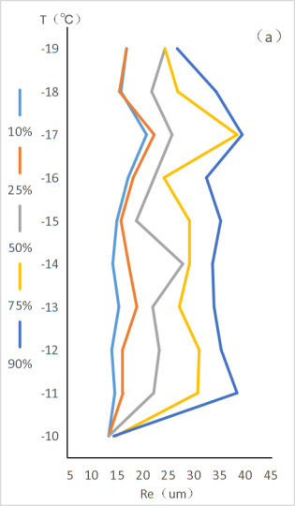
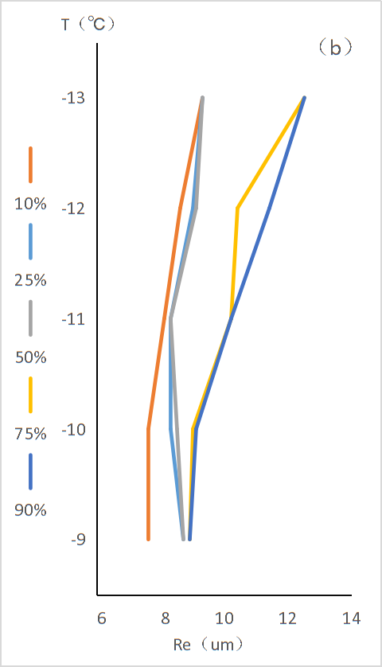
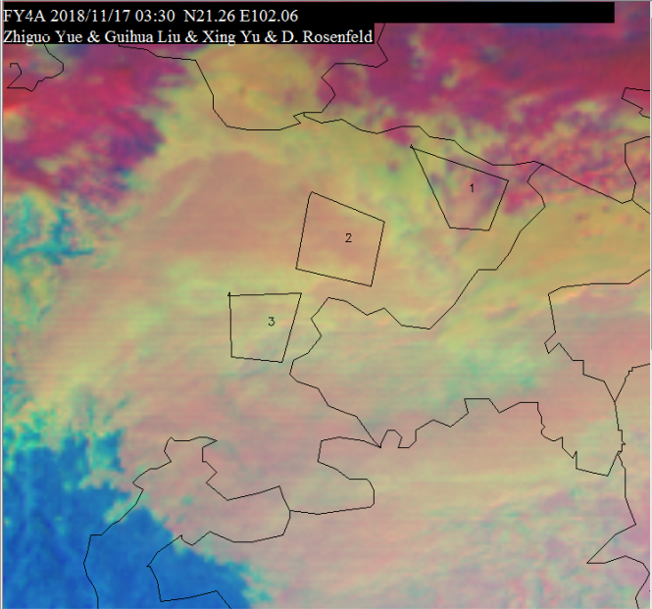
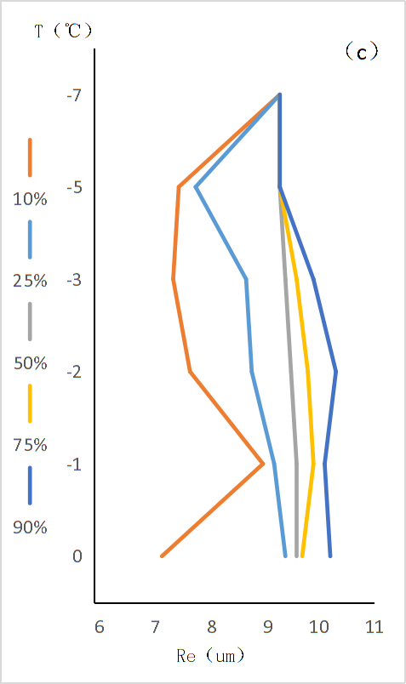
(1) Before rain enhancement operation
region3
T: 0℃ to -7℃
Re:<10um
(low clouds, liquid)
region1
T: -10℃ to -19℃
Re:15um to 35um
(large droplets,ice crystals)
region2
T: -9℃ to -13℃ Re:7um to 12um
(supercooled water area)
RGB image and T-Re profile at 11:30

Slide 26
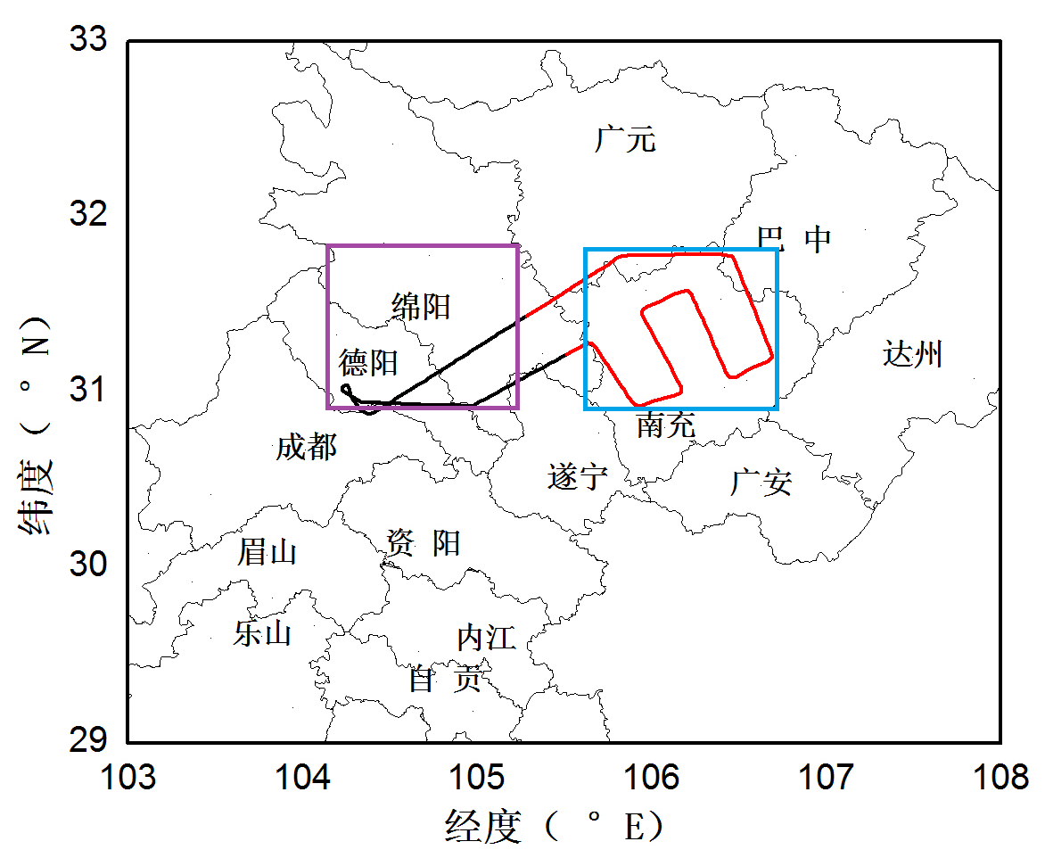
(2) Rain enhancement operation
This is operating track, the aircraft takes off at 11:40,arives at the target area at 12:00, then begins the catalytic operation.
The seeding is carried out along the "S" route, with sowing time of 1 hour (12:00~13:00).
The contrast area
The operation impact area
observation records
altitude: 5000m
temperature: -8℃
upper air speed:15m/s
wind direction:W

Slide 27
(2) Rain enhancement operation
cloud move eastwardly
15m/s 54km/h 0.5°/h

Slide 28
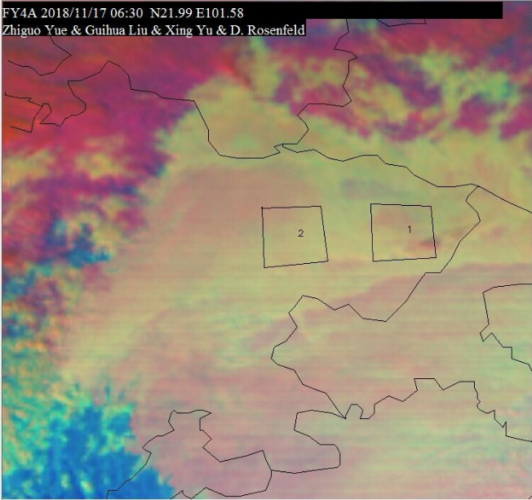
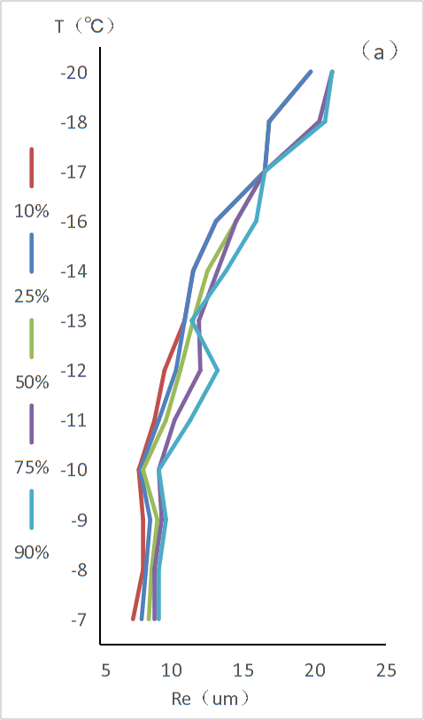
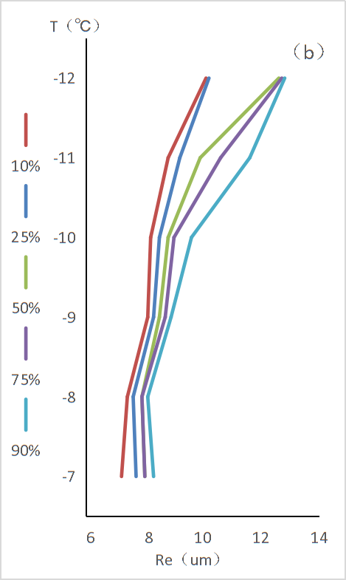
(3) Analysis after artificial rain enhancement operation
11:30
T: -9℃ to -13℃ T: -9℃ to -13℃
Re:7um to 12um Re:7um to 12um
14:30
T: -7℃ to -20℃ T: -7℃ to -12℃
Re:8um to 21um Re:7um to 13um
RGB image and T-Re profiles at 14:30

Slide 29
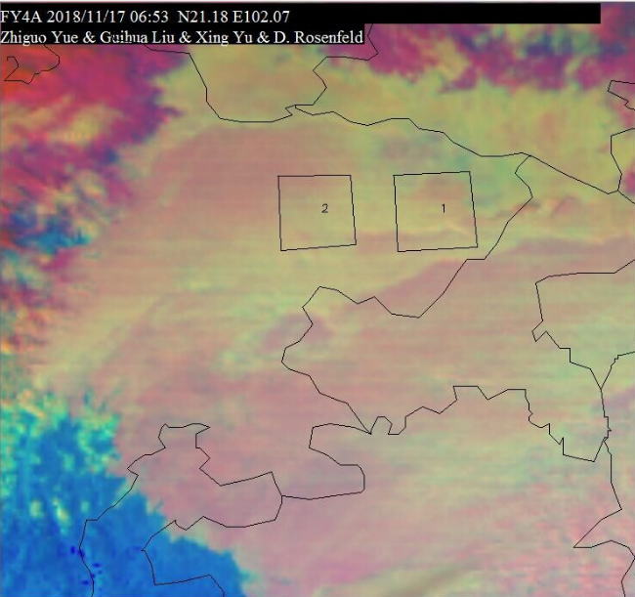
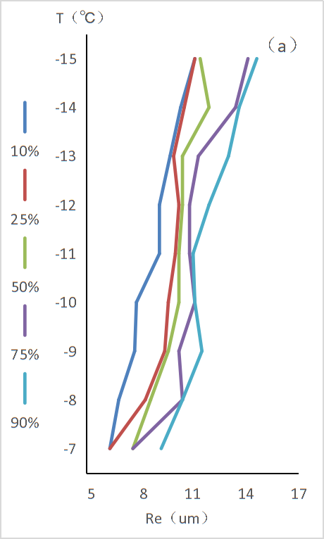
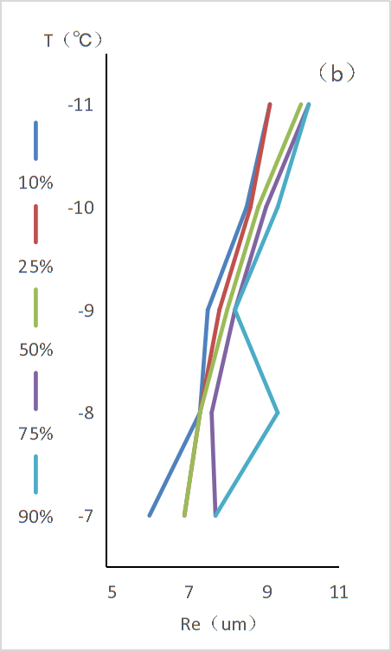
(3) Analysis after artificial rain enhancement operation
14:30
T: -7℃ to -20℃ T: -7℃ to -12℃
Re:8um to 21um Re:7um to 13um
14:53
T: -7℃ to -15℃ T: -7℃ to -11℃
Re:6um to 15um Re:6um to 10um
RGB image and T-Re profile at 14:53

Slide 30
THANKS!
Correspondence: ld8768@hotmail.com
wjwang1998@163.com

